Slide 1



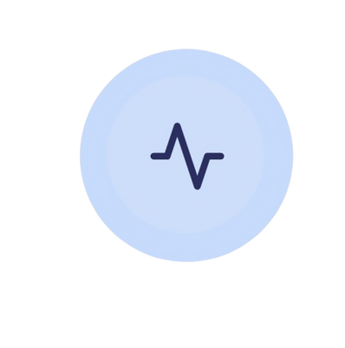
Medica
Smarter Healthcare, Better Decisions
SUPERVISED BY: DR. CHERRY AHMED
PREPARED BY:
Malak Wael Okasha
20216101
Nourhan Mohamed Zaki
20216113
Jana Adel Sobeih
20216031
Salma Hazem Salah
20216047
Nada Yasser Abdelsattar
20216110

Slide 2





THE PROBLEM
1. Fresh graduates often face challenges in prescribing medications and struggle with drug selection, alternatives, and interactions.
Increased risk of prescription errors and adverse drug reactions thus higher workload and stress for doctors and inefficient prescribing process affects patient safety.
2. Increased risk of prescription errors and adverse drug reactions thus higher workload and stress for doctors and inefficient prescribing process affects patient safety.
3. No centralized platform for pharmaceutical companies to update doctors so its difficult to stay informed about newly introduced medicines.

Slide 3

PROJECT IDEA
Our system MEDICA assists doctors in prescribing the right medications using machine learning to recommend treatments based on patient diagnosis and medical history.
MEDICA suggests optimal medications based on patient data and Identifies potential conflicts between prescribed drugs.
MEDICA helps doctors find substitutes during shortages and keeps doctors updated on newly introduced drugs.
Our domain of interest is the medical field

Slide 4

WHY SOLVE THESE
PROBLEMS?
To assist doctors—especially fresh graduates—in making informed prescriptions.
To reduce prescription errors and enhance patient safety.
To streamline communication between doctors and pharmaceutical companies.

Slide 5
HOW MEDICA
SOLVES THEM?
AI-powered medication recommendations for accurate prescriptions.
Real-time pharmaceutical updates to keep doctors informed.
A centralized platform for managing medicines, patient records, and treatment plans.

Slide 6

Drugs.com
An online drug database providing information
about medicines, their uses, side effects, and drug
interactions.
Cerner EHR
A system that helps hospitals manage
patient health records, treatment plans, and
doctor-patient interactions.
PREVIOUS SOLUTIONS
Ada Health
is an AI-driven symptom checker that
suggests possible treatments
MediLedger
A system that ensures drug authenticity
and secures the medicine supply chain

Slide 7

METHODOLOGY
We used hybrid Approach: Waterfall + Agile
Initial Planning (Waterfall):
Detailed requirement analysis and system design
Stakeholder consultations and documentation finalized early
Iterative Development (Agile):
Cycles of implementation, testing, and refinement
Continuous updates to design and documentation

Slide 8
METHODOLOGY
Phases Overview:
1. Requirement Analysis & Documentation
Functional & non-functional requirements gathered
Defined usability, reliability, and maintainability expectations
Security specifications were defined
2. System Design & Architecture
Modular architecture: Next.js (UI), Spring Boot (core logic), FastAPI (ML), PostgreSQL (DB)
Communication via RESTful APIs
Benefits: separation of concerns, scalability, security, extensibility

Slide 9
METHODOLOGY
3. Iterative Development & Testing
Feature-wise module development (e.g., auth, recommendation)
Unit & integration testing after each cycle
Regular feedback integration
Continuous documentation updates
4. Evaluation & Enhancement
Enhancements based on supervisor feedback and simulated scenarios:
UI/UX optimization
ML model refinement (data, hyperparameters, integration)

Slide 10
PROJECT SPECIFICATIONS
1
5
System Architecture
Use-case Diagram
2
6
Stakeholders
Class Diagram
3
7
Functional Requirements
Sequence Diagram
4
8
Non-Functional Requirements
Component Diagram
9
ERD

Slide 11

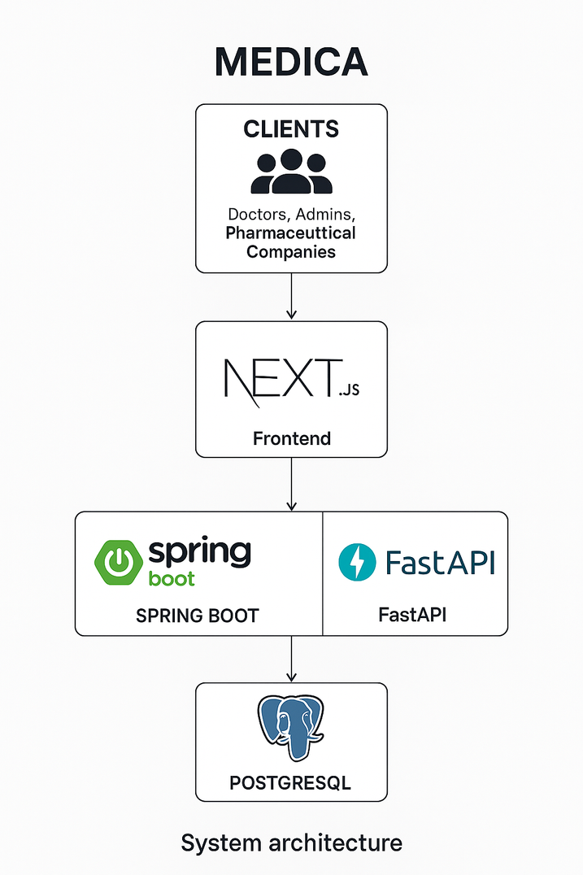
Medica uses a modular, service-oriented architecture with four layers: client, frontend, backend, and data storage.
System Architecture
A Next.js web interface allows access for users (doctors, admins, pharma companies).
The frontend connects via REST APIs to:
Spring Boot: Core logic, user management, and PostgreSQL access.
FastAPI: Independent ML services (medicine recommendation, suitability).
The design ensures modularity, scalability, and separation of concerns.

Slide 12
DATASETS
1. Medicines Usage, Side Effects & Substitutes
Covers 248,000+ drugs from global manufacturers. Supports Medica system with detailed drug data.
It is used in the search medicine feature
2. Drug-Drug Interactions
Sourced from DrugBank. Enhances safety by identifying and explaining drug interactions.
Improves prescription accuracy, reduces adverse reactions, and supports data-driven decisions in pharmacology.
It is used in the Drug to Drug Interaction feature

Slide 13
DATASETS
3. Predict medicine Dataset
This dataset supports clinically relevant, individualized medicine predictions
by encoding real-world constraints into synthetic patient records.
It is used in the ML-based functionality “Customized Medicine Recommendation ”
4. Predict Improvement Dataset
A synthetic dataset developed to support ML-based prediction of treatment outcomes. It enables assessment of whether prescribed medications are likely to improve patient conditions.
It is used in the ML-based functionality “Assess Medicine Suitability ”

Slide 14

Internal Stakeholders
Stakeholders
Developers
Designers
Testers
Project Managers
External Stakeholders
Administrators
Doctors
Patients
Pharmaceutical Companies

Slide 15
Functional Requirements
Admin Features
4
1
Create and Manage Doctor Account
Sign up
5
2
Create and Manage Admin Accounts
Login
3
6
Logout
Create and Manage Pharmaceutical Companies Accounts
7
Create and Manage Admin Accounts

Slide 16

Functional Requirements
Doctors Features
4
1
Add Patient Visit
Login
5
2
View Patient Information
Search for Medicines
3
6
Add Patient
View Patient Visits
7
View Visit Details

Slide 17
Functional Requirements
Doctors Features
8
11
Assess Medicine Suitability
View Assigned Patients
9
12
View Registered Companies & Medicines
Customized Medicine Recommendation
10
13
Add Company to Favourites
Check Drug Interactions

Slide 18

Functional Requirements
Pharmaceutical Companies Features
1
3
Add Medicine
Login
2
4
Add Medicine Dataset
Remove Medicine
5
View Registered Companies & Medicines

Slide 19
NON-FUNCTIONAL REQUIREMENTS
1
1
2
Performance
2
Reliability
Optimized SQL queries were used to increase performance and reduce the response time.
Data consistency shall be maintained across all components, particularly for patient data and prescription details.
3
Usability
4
3
Maintainability
User interface ( UI)
–User friendly interface, reducing
the learning curve for the users
Modular design, so that components can be independently updated or replaced.
Clear code documentation for all modules to facilitate easier maintenance and future development.

Slide 20
NON-FUNCTIONAL REQUIREMENTS
5
Security
2
1
2
Password Security:
A strong password policy is enforced across all user roles.
2. All passwords are hashed before being stored in the database.
System Design and Documentation:
Documented the system design and architecture.
Documented role-based privileges for admin, doctor, and pharma users
3
Access Control:
Role-Based Access Control (RBAC) defines strict user permissions
Secure session management; restricted access to authenticated users

Slide 21
NON-FUNCTIONAL REQUIREMENTS
5
Security
2
1
2
Protection Against Common Vulnerabilities:
SQL Injection Prevention
Cryptographic hashing for sensitive data
No exposure of internal details or stack traces on failure
Logging & Auditing:
Logs key user actions: account creation/deletion, info updates, logins
Logs securely stored for auditing and incident tracking
3
File Upload Security:
Strict file type restrictions for uploads
SSL Communication:
SSL encryption secures data transmission between Spring Boot backend and PostgreSQL
Ensures confidentiality and integrity of in-transit data

Slide 22
NON-FUNCTIONAL REQUIREMENTS
5
Security
2
1
2
Failure to Authenticate / Unauthorized Access:
Role-based access with least privilege enforcement
Unauthorized users denied access by default
Data Integrity & Privacy:
SSL encryption secures sensitive data exchanges (e.g., patient records)
Adheres to healthcare data protection best practices
3
URL Privacy Measures:
User IDs are hashed in URLs
Prevents exposure of sensitive user identifiers in web requests

Slide 23
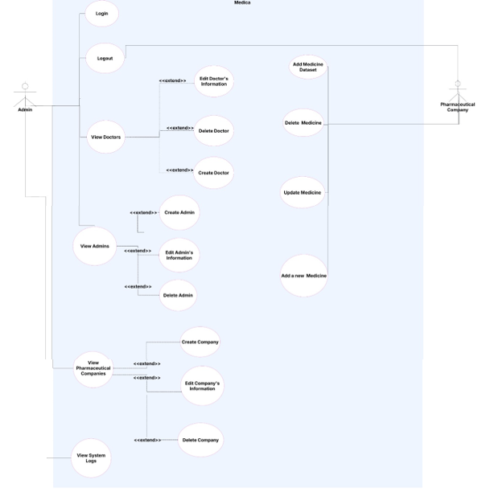
USE-CASE I
The use case diagram illustrates the various functionalities available to different user roles within the system.
It primarily focuses on the actions that an Admin and Pharmaceutical Company can execute.

Slide 24
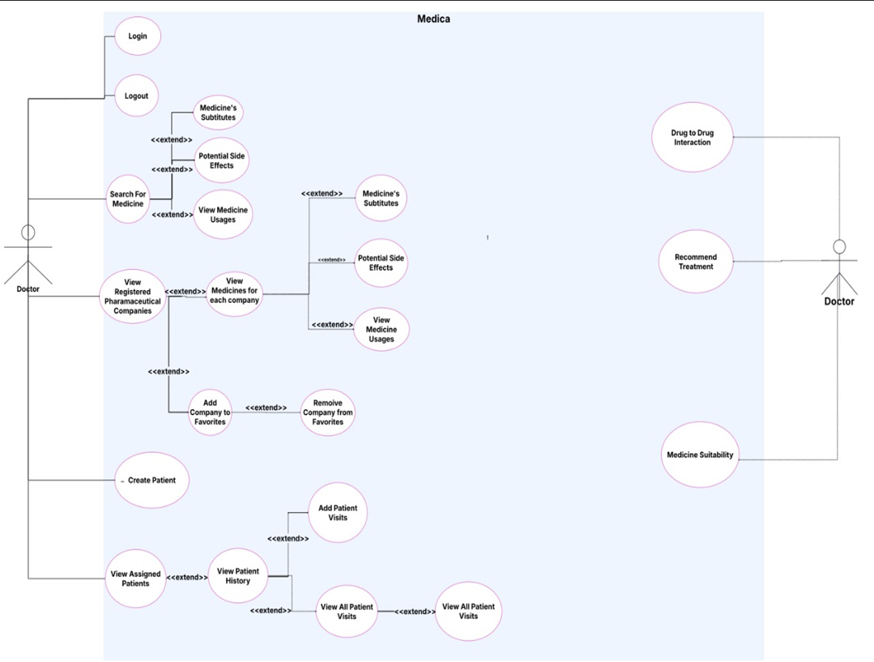
USE-CASE II
This use case diagram illustrates the various functionalities available to Doctors within the Medica system.
It highlights key operations that doctors can perform, including patient management, medicine research, pharmaceutical company interactions, and notifications.

Slide 25
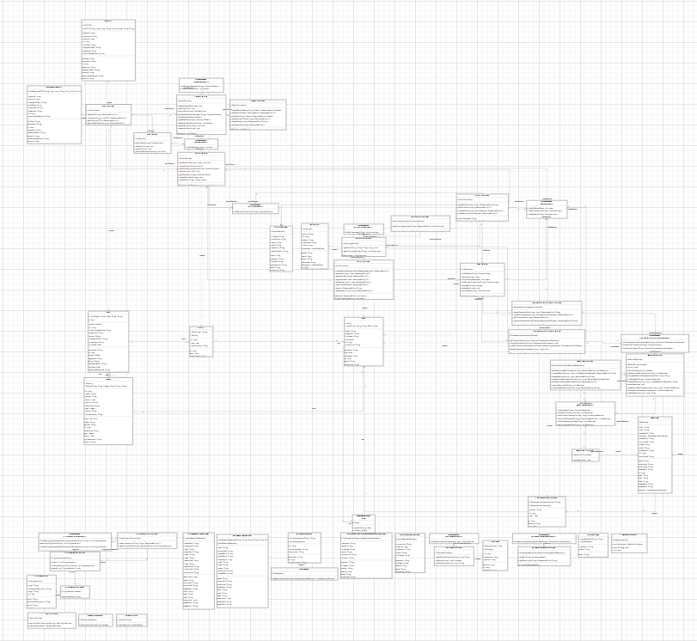
CLASS DIAGRAM
Our class diagram outlines key system entities, their attributes, methods, and interactions, including users, doctors, admins, patients, and pharmaceutical companies.
View Class diagram

Slide 26
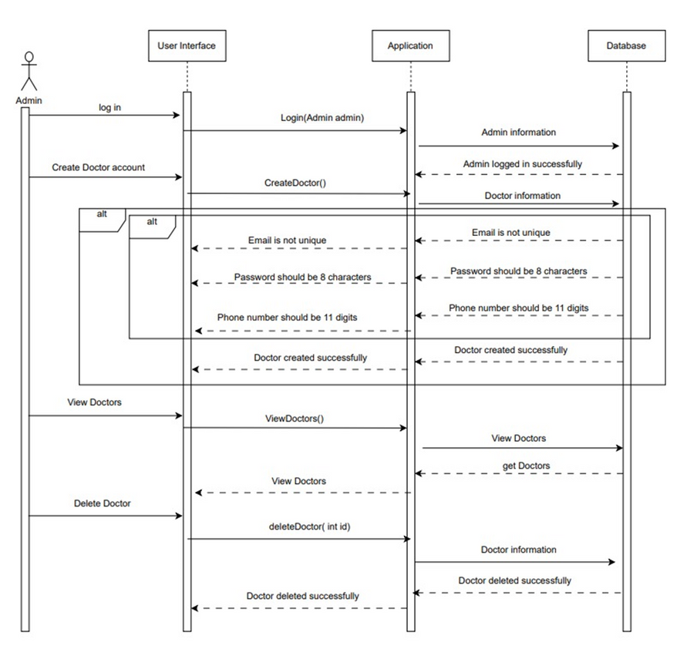
SEQUENCE DIAGRAM I
The admin logs in and creates a doctor account by entering details like name, specialization and contact.
The system validates data and confirms creation.
The admin can view a list of registered doctors retrieved from the database.
The admin can delete a doctor’s account, and the system removes the record, confirming deletion.

Slide 27
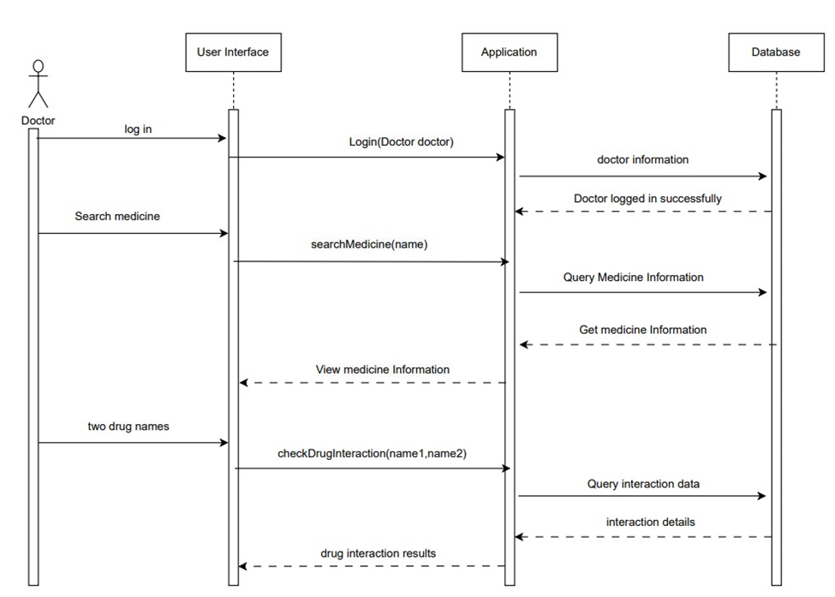
SEQUENCE DIAGRAM II
The doctor logs into the system using their registered credentials. Upon successful authentication, access is granted.
The doctor searches for a specific medicine. The system retrieves and displays relevant details.
The doctor can input two medications to check for drug interactions.

Slide 28
SEQUENCE DIAGRAM III
Doctor initiates medicine recommendation via Medi Bot
Patient data and diagnosis are submitted
ML model predicts the most suitable substance.
Recommendation is returned and displayed to the doctor

Slide 29
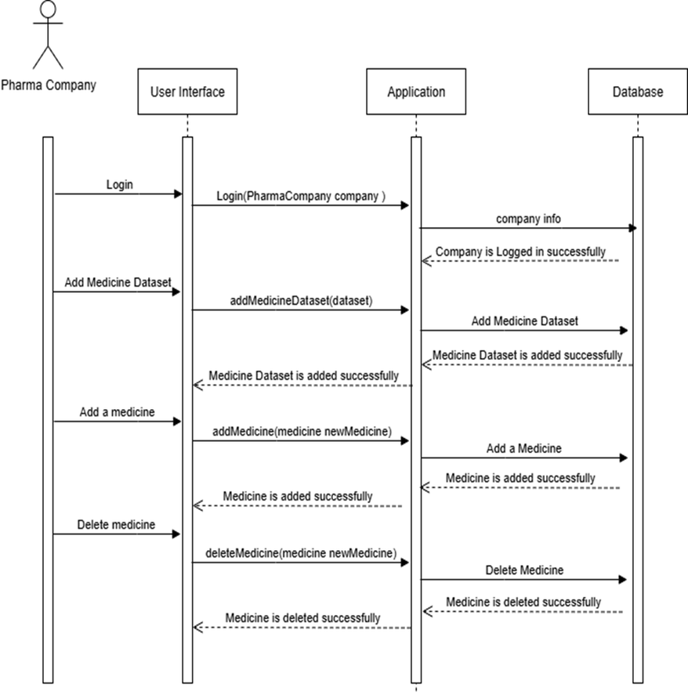
SEQUENCE DIAGRAM IV
The company logs in using its credentials .
The company adds a medicine dataset, which is stored in the system.
The company adds a new medicine with details like name, uses, and side effects.
The company deletes a previously added medicine, and the system confirms removal.

Slide 30
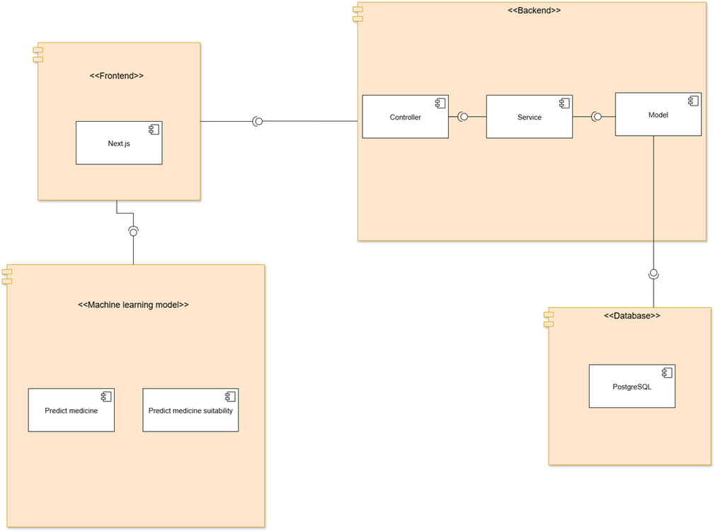
COMPONENT DIAGRAM
Frontend (Next.js): Web interface for user interaction
Backend (Spring Boot): Handles logic, APIs, and database access
Database (PostgreSQL): Stores patient, user, and drug data
ML Model (FastAPI):
Predict Medicine: Suggests best treatment
Suitability Check: Evaluates effectiveness of prescribed drug

Slide 31
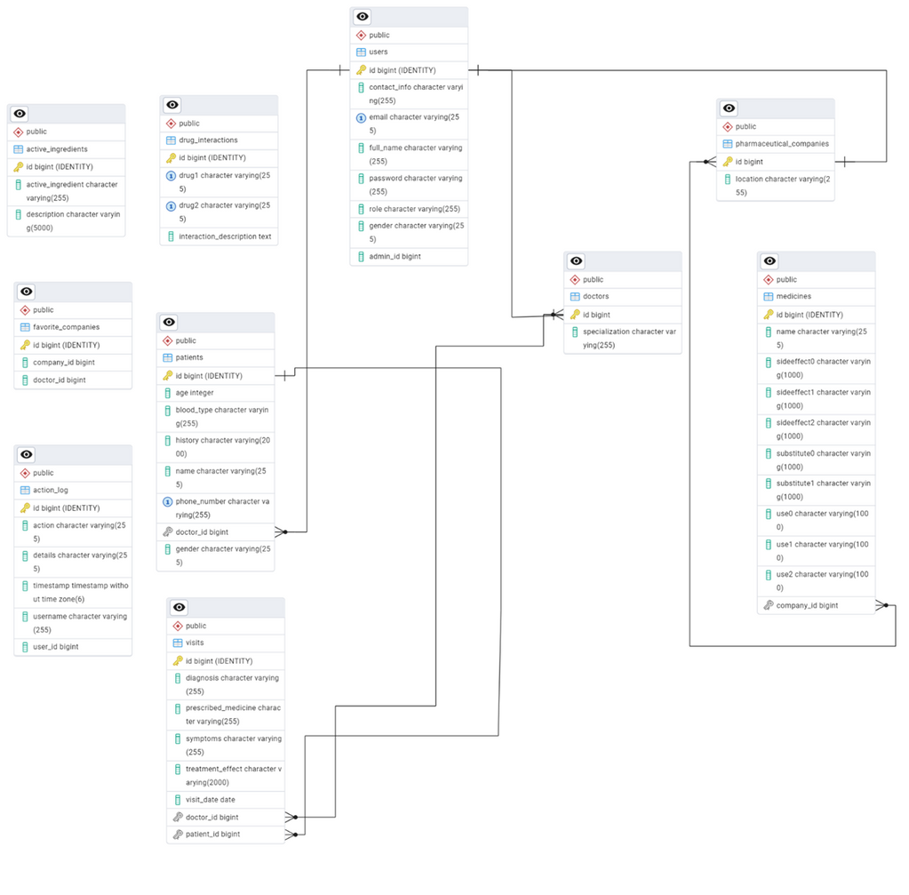
ERD
Our diagram illustrates the database schema, it shows various tables and their relationships.
These relationships ensure efficient data organization, enabling seamless interactions between entities.

Slide 32
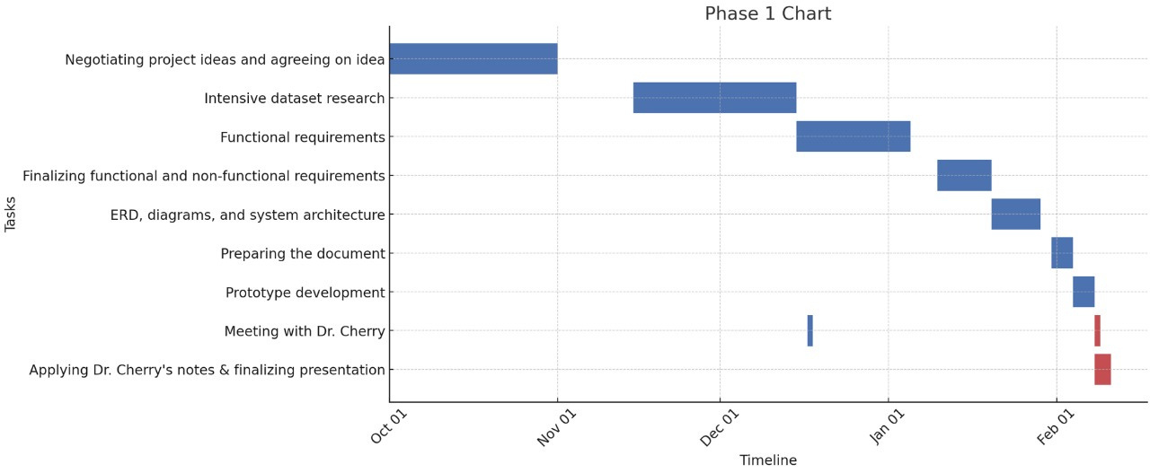
PHASE I
Time
Plan

Slide 33
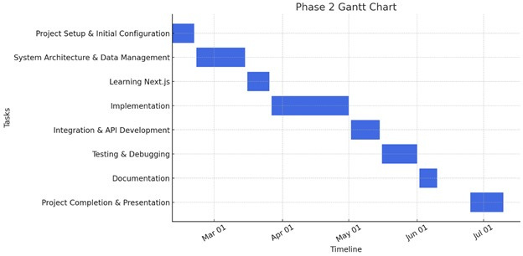
PHASE II
Time
Plan

Slide 34
IMPLEMENTATION
Tools
Machine Learning Implementation

Slide 35
Tools
1
2
1
Backend Services
Machine Learning
& Data Science
FastAPI
Java Spring Boot
Python
Jupyter Notebook
Scikit-learn
NumPy
Pandas
Matplotlib
3
Database
PostgreSQL
3
4
Frontend
Next.js

Slide 36
Tools
8
1
Security
SSL
9
Development
& Collaboration
3
Github
10
IDEs
PyCharm
IntelliJ IDEA
Visual Studio Code

Slide 37
MACHINE LEARNING
IMPLEMENTATION
Challenges with Existing Datasets
Lacked key features (e.g., allergies, outcomes, clinical tests)
Limited scope of conditions and medications
Incompatible with model requirements
Increased risk of prescription errors and adverse drug reactions thus higher workload and stress for doctors and inefficient prescribing process affects patient safety.
Why Synthetic Data?
Custom datasets ensured needed features and clinical realism
Simulated real-world scenarios for both ML tasks
Balanced accuracy, complexity, and medical relevance
Outcome
Two high-quality synthetic datasets created
One for recommending medications
One for assessing treatment suitability
Formed the foundation of both ML features in Medica

Slide 38

KEY PREPROCESSING STEPS
Label encoding for categorical variables
Handling missing categorical values
Handling missing numerical values
Stratified train/test splits (80/20)

Slide 39
Recommend Medicine – Model Pipeline
1
3
2
1
2
Model Objective
Best Model
Predict appropriate medication using:
Age, gender, diagnosis, allergies, chronic conditions
XGBoost (Accuracy: 96.3%)
Compared models: XGBoost, CatBoost, LightGBM
Dataset
4
2
Features
15,000 synthetic records
Label noise added (5%) to simulate real-world variability
Diagnosis
Allergies
Chronic conditions
Age
Gender
3

Slide 40
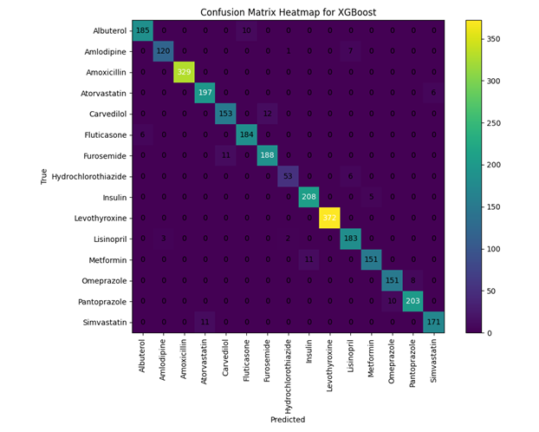
Recommend Medicine – Evaluation
The confusion matrix for the best model (XGBoost) was generated to evaluate the model's classification performance.
The matrix shows the true positive, false positive, true negative, and false negative counts for the predicted medications:

Slide 41
Predict Suitability – Model Pipeline
1
3
2
1
2
Model Objective
Best Model
Predict whether a prescribed medicine leads to patient improvement
LightGBM / CatBoost (Accuracy: 96.5%)
Also evaluated: XGBoost, Random Forest
2
4
Dataset
Key Features
15,000 synthetic records
Label noise added (5%) to simulate real-world variability
Demographics, diagnosis, medicine, allergies
Chronic conditions, severity, smoking status
Disease-specific medical test results (e.g., HbA1c, TSH, LDL)
3

Slide 42
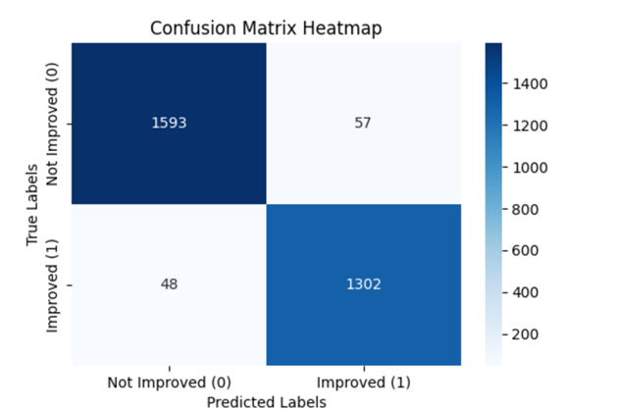
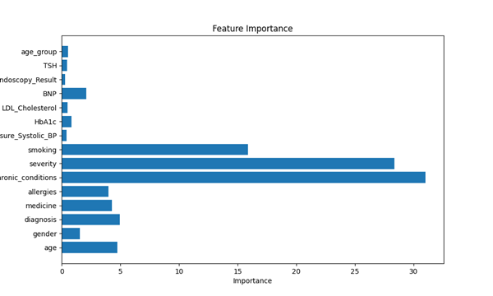
Predict Suitability – Evaluation
Model Evaluation
Confusion matrix: Strong class discrimination
High accuracy and balanced predictions
Feature Importance
Most impactful: chronic conditions, severity, smoking, systolic BP
Least impactful: gender, raw age

Slide 43
TESTING
Initially performed unit testing for each functionality using Postman
Followed by integration testing in Postman after backend implementation
Prepared and executed test cases covering both valid and invalid inputs
Integrated the frontend with the backend using the exposed API endpoints and tested each functionality to ensure proper error handling
Conducted full system integration testing to validate end-to-end functionality and ensure smooth user flow
Engaged in team-based debugging and validation to ensure complete functionality across the system

Slide 44
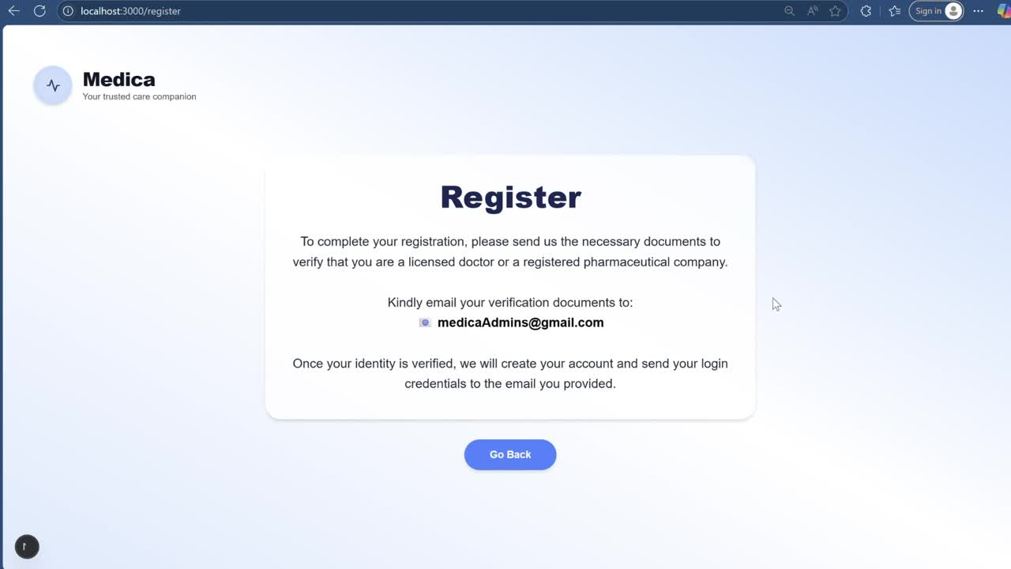
MEDICA DEMO

Slide 45
FUTURE WORK
Develop mobile applications (Android/iOS) for enhanced accessibility.
We will aim to obtain real-world clinical datasets from hospitals to be used in our machine learning models.
Implement multi-language support and tailor interfaces and content to align with local clinical practices and medical terminologies.

Slide 46
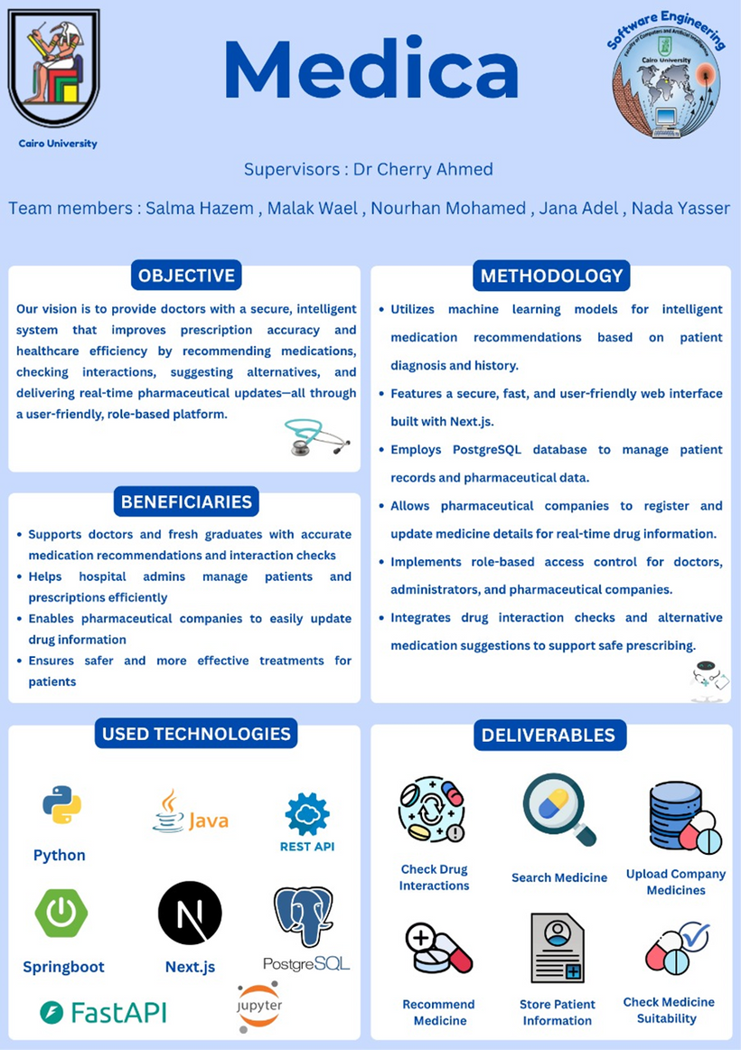
POSTER

Slide 47
Before MEDICA, doctors struggled with prescribing the right medications due to scattered resources, lack of real-time pharmaceutical updates, and manual patient record management.
These challenges led to increased prescription errors, inefficiencies, and difficulty in tracking patient history.
MEDICA came to solve these problems by providing ML-powered medication recommendations, real-time drug updates, and a centralized patient management system.
This ensures less faulty prescriptions, reduces errors, and enhances healthcare efficiency while increasing performance, reliability, and usability.
Conclusion

Slide 48
Thank You!

